Slide 1
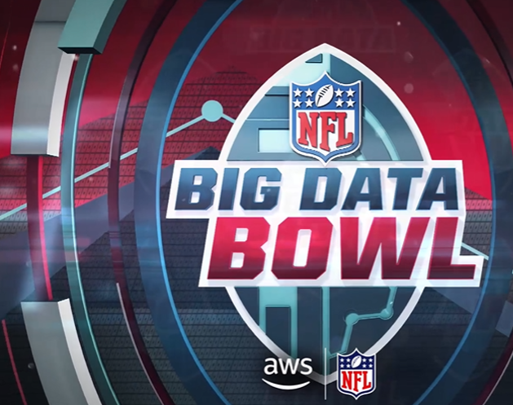
Mind the Gap: Using Pre-Snap Data for Insights Into the Run Game
Josh Moore, Michael Rom, and Liz Giel
December 2024
Notes:
Welcome to our presentation for the Big Data Bowl 2025. We have been tasked with using data from Next Gen Stats powered by Amazon. Since we elected to pursue the coaching track, we aim to create a scouting report that will help teams gain an edge with game-planning. We take a dive into the run game and what tendencies and predictions can be obtained from pre-snap player tracking data. Through the data science process, we will show which features are most important; particularly, whether running back depth is significant in predicting whether a play will be a run or pass.

Slide 2
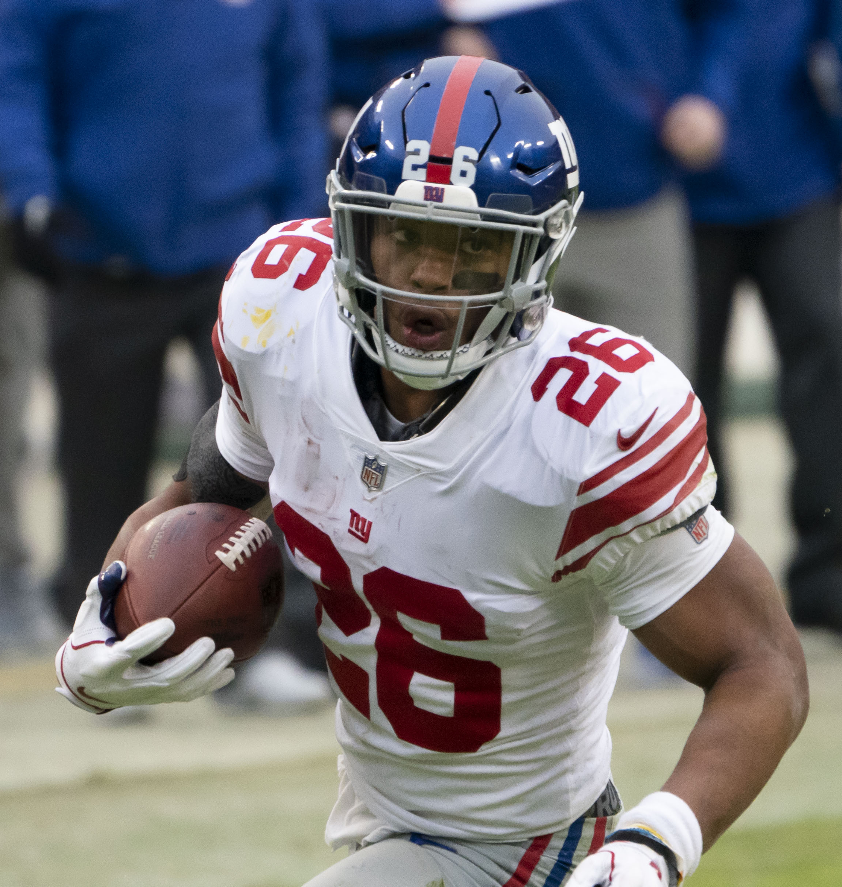

Background
Notes:
The Big Data Bowl (BDB) is in its seventh year of competition. With the advancement of data analytics and its availability, more and more focus is being placed on developing insights from that data. This year the BDB has challenged competitors to develop actionable insight from pre-snap player tracking data. When one watches a game, there will be times that where it is fairly obvious what the offense is about to do. Think about the Philadelphia “Tush-Push” or the ball is at the 50 and time is about to expire, and the offense needs a Hail Mary Miracle. However, it the normal progress of a game, it may not be as obvious, and this is where the real insight begins.

Slide 3
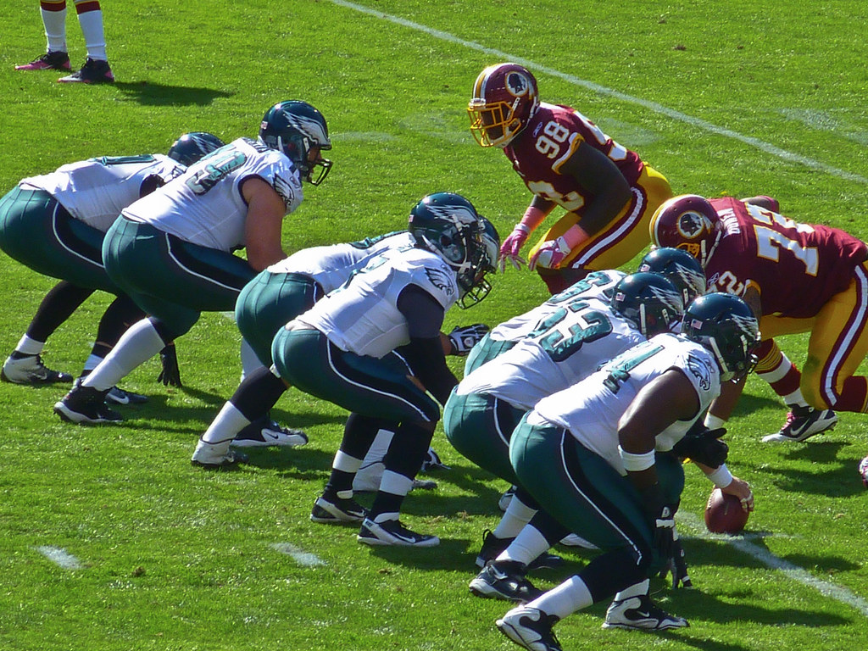
Purpose of Analysis
Run or Pass
Pre-Snap Tracking Data
Important Variables
Predictability of running back depth
Notes:
Our goal is to predict whether a play will be a run or pass by analyzing pre-snap player tracking data that includes formations, motion, shifts, personnel type, down and distance, and specific player positioning. Furthermore, we seek to test our theory that running back depth is significant in determining play type. For this analysis we will be using the data provided by the competition.

Slide 4
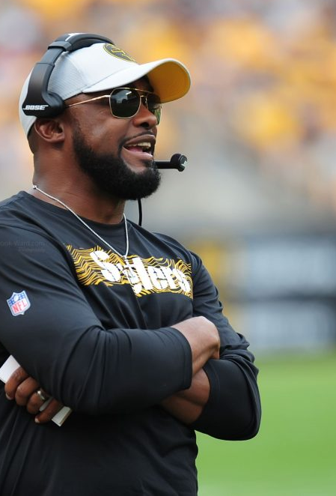
Problem Statement
Complex Schemes
Fast-Paced Offenses
Real-Time & Halftime Adjustments
Tendencies
This Photo by Unknown Author is licensed under CC BY-NC
Notes:
When Phil Mickelson sat down with David Feherty for his weekly TV show, he went through the numerous parameters he goes through for every shot in between tee to green. Now picture having to assess a relatively similar number of factors to call a play before the offense snaps the ball. There in lies the challenge. Coordinators must make these decisions in real-time, and sometimes very quick when facing a face-paced offense. Our challenge is sifting through the different variables to include formations, down and distance, play shifts, player motion, motion at the snap, receive alignment, time left in the game, score, and so on. Anyone has a 50/50 chance of guessing whether a play is a run or pass, but coaches have to be better than that. Likewise, offensive coordinators develop schemes to appear balanced and unpredictable but can they out-run the data and hidden tendencies that might exists. Again, this report can serve useful to both defensive and offensive coordinators.

Slide 5
Importance of Predictive Analytics
Notes:
Predictive analytics reveal hidden patterns in formations, alignments, and motion, offering insights that coaches can use to outsmart opponents. These insights can help teams optimize play calls, adapt strategies, and make data-informed adjustments on the field. Additionally, coaches can develop insights from predictive modeling and test different strategies and engineered features to gain an even bigger edge that opponents may not realize they’re doing. Sometimes the tendency can be so easy to spot like a quarter back who has a playbook armband on each arm, one for running plays and one for passing plays. However, with the sophistication of the NFL, it is unlikely finding tendencies will be this easy.

Slide 6
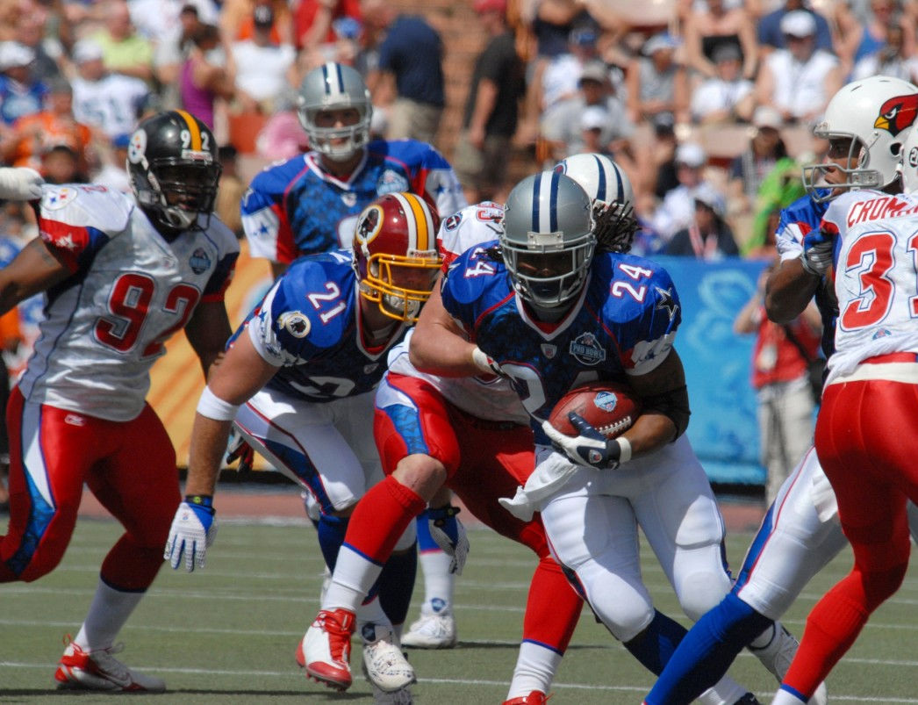
Dataset Overview
13 CSV Files
9 Weeks of 2022 Player Tracking
~58.7 million records
~150 Columns of Data
Games, Plays and Players
Tracking Data Must be Used
Notes:
The BDB provided 13 different tables in the form of comma separated value files with approximately 150 combined columns and about 58.7 million records. Four of the files consisted of player data, game data, play data, and player play data. The bulk of the data was found in the 9 weeks of player tracking data for every play in every game during that time. When combined there were over 50 million records with a size of about 8.2 GB.

Slide 7
Data Cleaning, Preparation, Preprocessing, & Transformation
Notes:
We began our analysis as most and cleaned, prepared, preprocessed and transformed the data. Next removed features that were associated with post-snap data, removed data where the play would result in a penalty like having two men in motion at the snap, and systematically progressed through each week of tracking data by aggregating, encoding, engineering features, and merging the tables. Lastly, we concatenated the 9 different aggregated tables to develop a final aggregated table that consisted of just over 16000 rows and 35 columns – a much more manageable file at 4.2 MB. At this point, we developed descriptive visuals that could possibly reveal trends and break-downs the are readily accessible in the data.

Slide 8
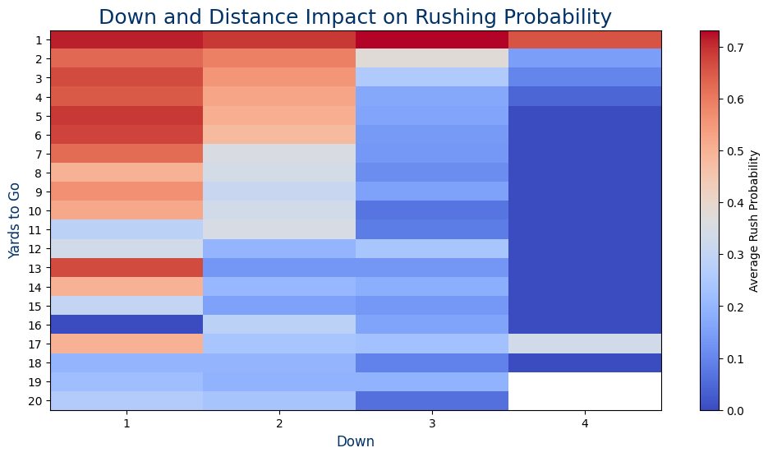
Down and Distance & Rushing Probability
Trend:
On early downs (1st and 2nd), rushing probability is higher.
In short-yardage situations (e.g., fewer than 2 yards to go, rushing becomes the preferred play.
Teams prioritize rushing plays to maintain manageable scenarios or exploit defensive weaknesses.
Strategic Tendencies:
Coaches favor rushing to control the clock and set up better passing opportunities on subsequent downs.
Longer distances (10+ yards) reduce the likelihood of rushing.
Conclusion:
Down and distance are crucial predictors of play-calling strategy, offering actionable insights for game planning and predictive modeling.
Notes:
It will come as no surprise that as the down and distance increases, the probability of pass coming is increasing. The same can be said for when the distance to get a first down decreases, the probability of seeing a run play increases. As seen in the chart, this trend is evident. However, one interesting not is that teams were more likely to fun the ball on first down with 10 or less yards to go, and second down with 6 or less yards to go. A few anomalies were found like the tendency to run the ball on first down

Slide 9
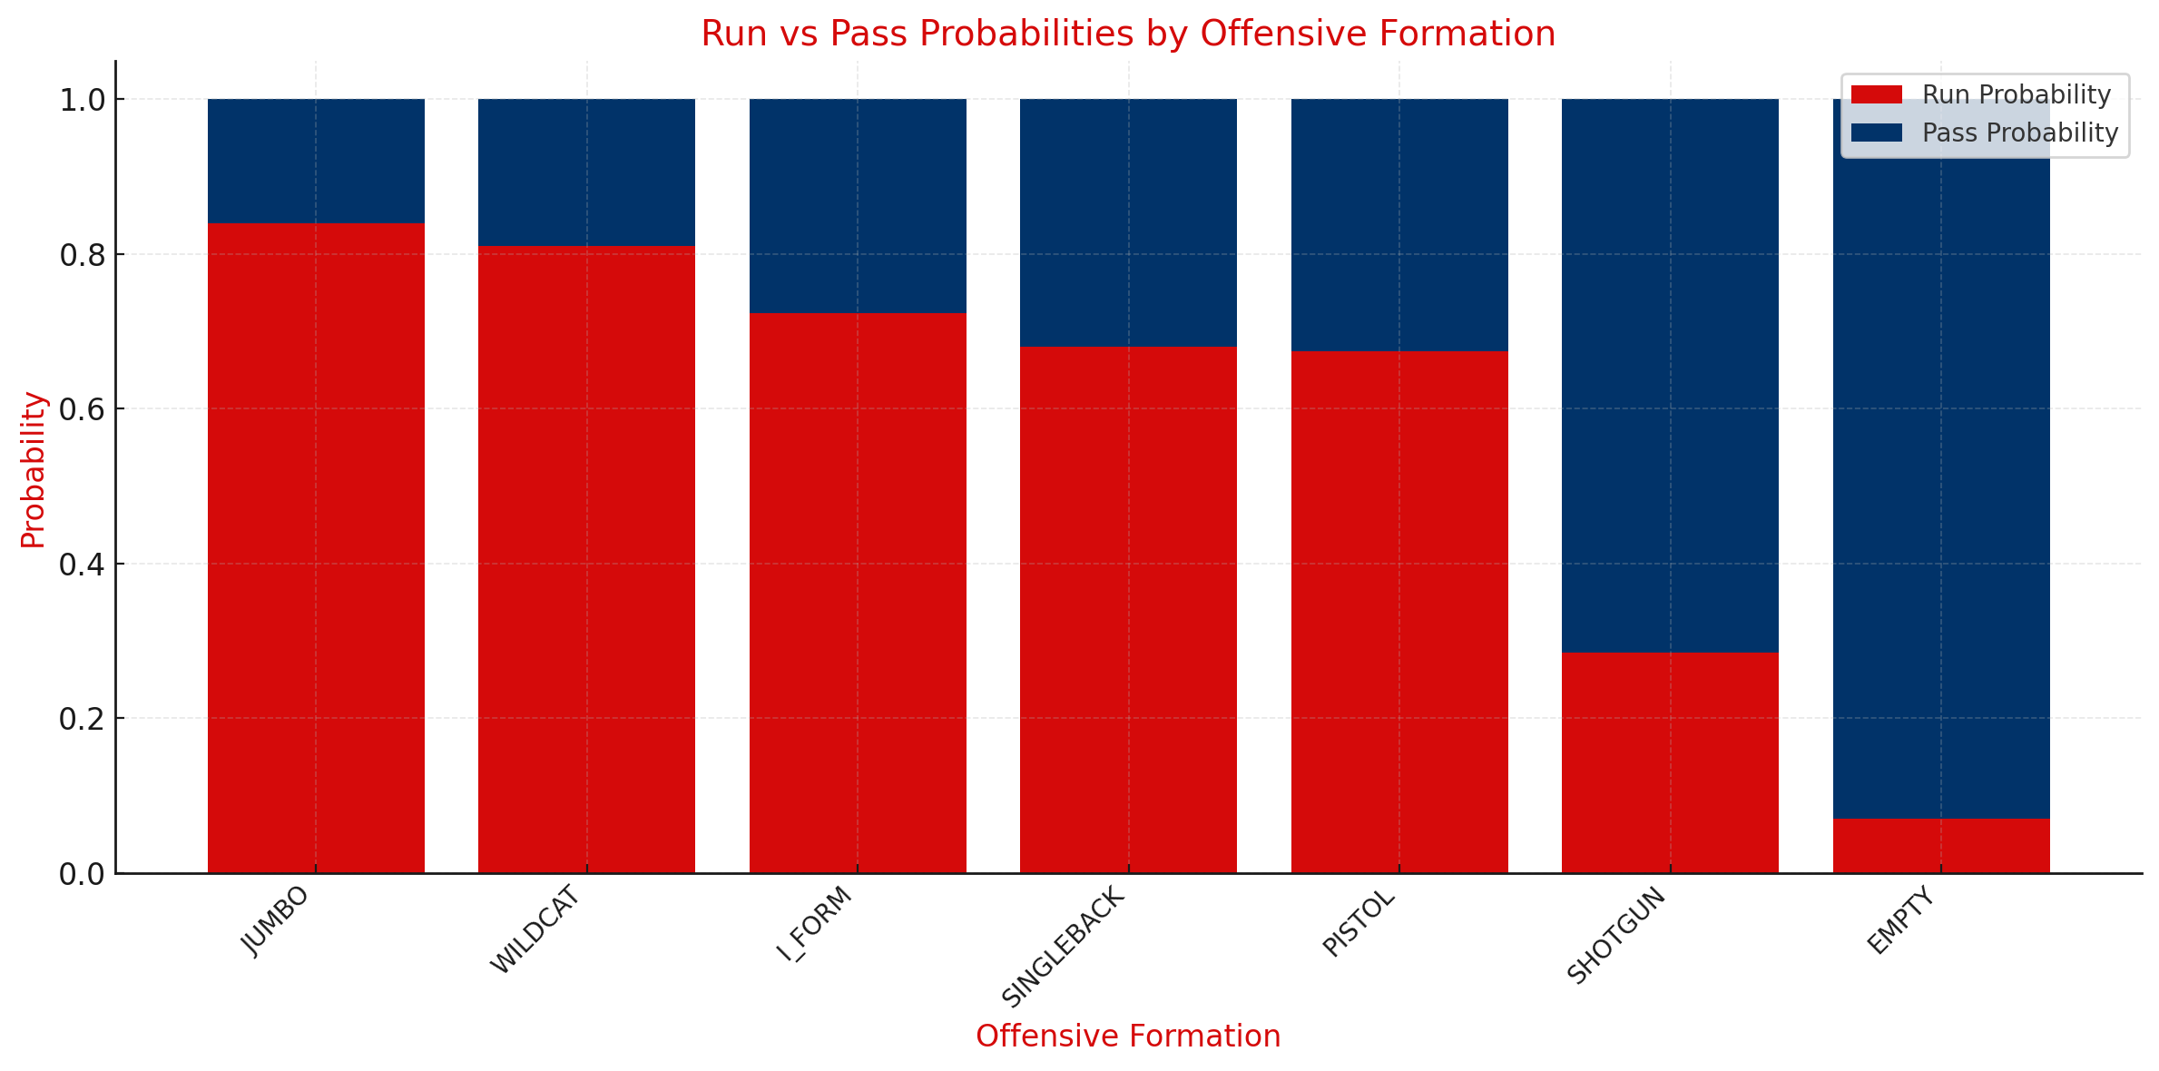
Run vs. Pass Probabilities by Formation
Run Heavy:
Jumbo
Wildcat
Pass Heavy:
Empty
Shotgun
Run Likely:
I-Formation
Singleback
Pistol
Notes:
Again, the descriptive analytics confirms that when teams are in certain formations like Jumbo or Wildcat, they are more likely to run the ball, and when there are not running backs in the backfield (Empty) they are more likely to pass. However, the empty set can be tricky when teams have explosive quarterbacks like Lamar Jackson, Geno Smith, or Patrick Mahomes.

Slide 10
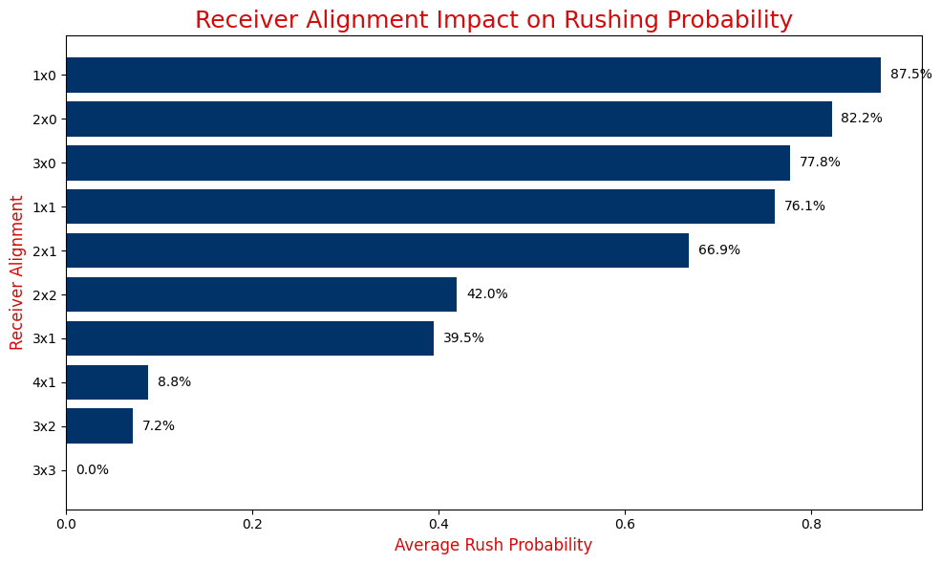
Receiver Alignment & Run Probability
Run Likely
Few Receivers
Offset or Unbalanced
Pass Likely
Numerous Receivers
Balanced Formation
Notes:
Another discovery included receiver alignment. Most of the alignment findings are obvious but some are more subtle. The more receivers the more likely a pass, but if the receiver alignment was unbalanced then a run could be predicted. Also, fewer receiver typically indicates a run is on the way.

Slide 11
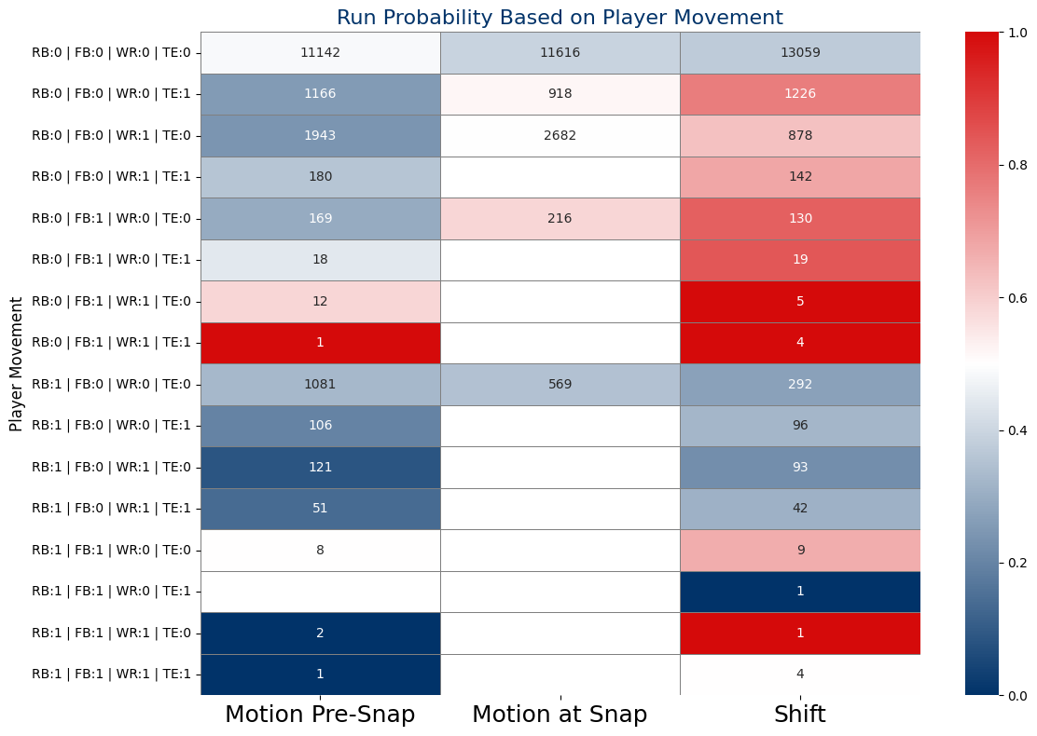
Player Movement & Play Type
Motion Pre-Snap
More likely to pass
Motion at Snap
Balanced, but pass likely
Shift
Run likely if FB shifts
Pass likely if no shift
Notes:
Here we begin to see some patterns emerging that may not have been so evident like the more obvious indicators. First, when a fullback is in the game, and especially if he shifts, there is a high probability it is a run play. Likewise, if the team doesn’t shift at all there tends to be slightly higher probability of a pass play. Wide receiver motion is very popular in the dataset and was very balanced and should little variance between pass and run; most likely this is used to induce defenses into making shifts of their own that may actually help the offense.

Slide 12
Modeling Approach
Notes:
We elected to use rushLocationType as our target variable because if the play was a run, it had a value and if it was a pass play it was null. We engineered this variable to be binary with 1 being a run play and 0 being a pass play. The variable was ‘target_rush’. One-Hot encoding was used for shift, motions, and motion at snap, and additional features were engineered measuring running back, fullback, and quarterback depth at the time of the snap. Continuous variables were standardized, and Boolean variables were created as an integer type. Although some predictive models are fully capable of handling several of these tasks, we elected to take care of this on the front-end before modeling. We utilized XGBoost and LightGBM predictive models. Feature importance was conducted with XGBoost model. Bayesian optimization was used to fine-tune hyperparameters, but GridSearchCV and RandomizedSearch were also performed to ensure we obtained the most accurate parameters. , LightGBM proved to be the most effective, correctly predicting whether a play was a run or pass 77.3% of the time. Additionally, it achieved a high ROC-AUC score of 85.1%, which describes how well the model distinguishes between run and pass plays. This means the model is reliable not just in accuracy but also in understanding subtle patterns. Using XGBoost, we also identified the most important factors contributing to predictions, such as offensive formations, wide receiver alignment, and running back depth, giving us actionable insights into what drives play type tendencies.

Slide 13
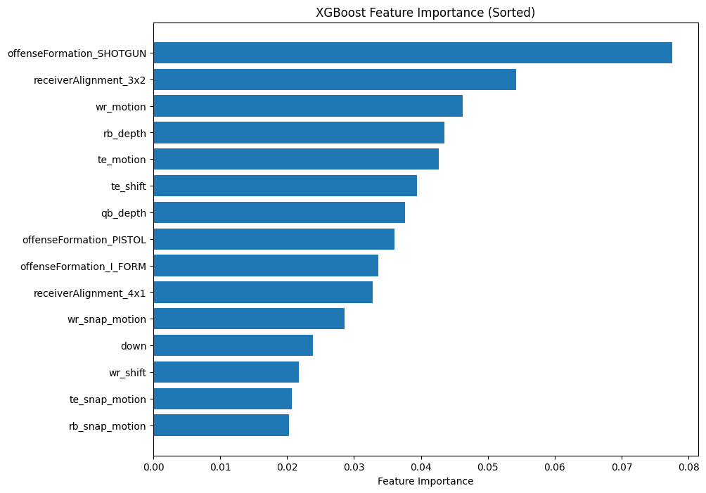
Feature Importance
Which variables provide the most gain
Running Back (rb_depth) significant
Shifting creates predictive gain
Notes:
With feature importance, don’t be fooled when looking at this chart and thinking “Shotgun formation means run?” That would be a mistake. This is simply saying these features, or variables, in the data had the most gain for the predictive model. As we can see, rb_depth is up near the top, which is a good indicator for our hypothesis that running back depth is statistically significant in predicting whether a play will be a run or pass.

Slide 14
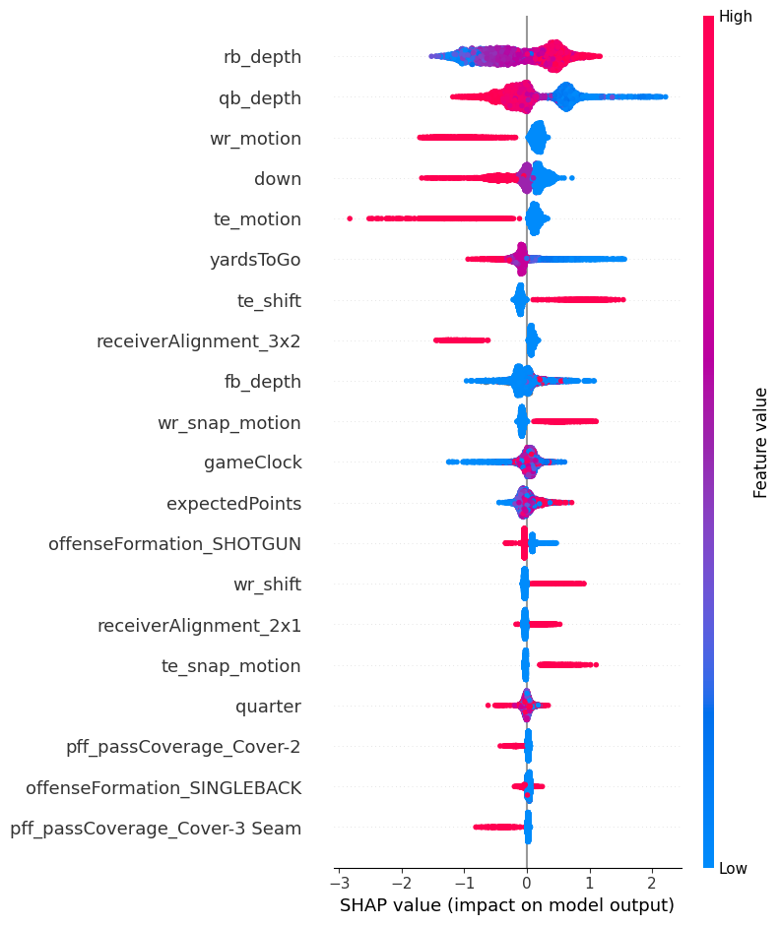
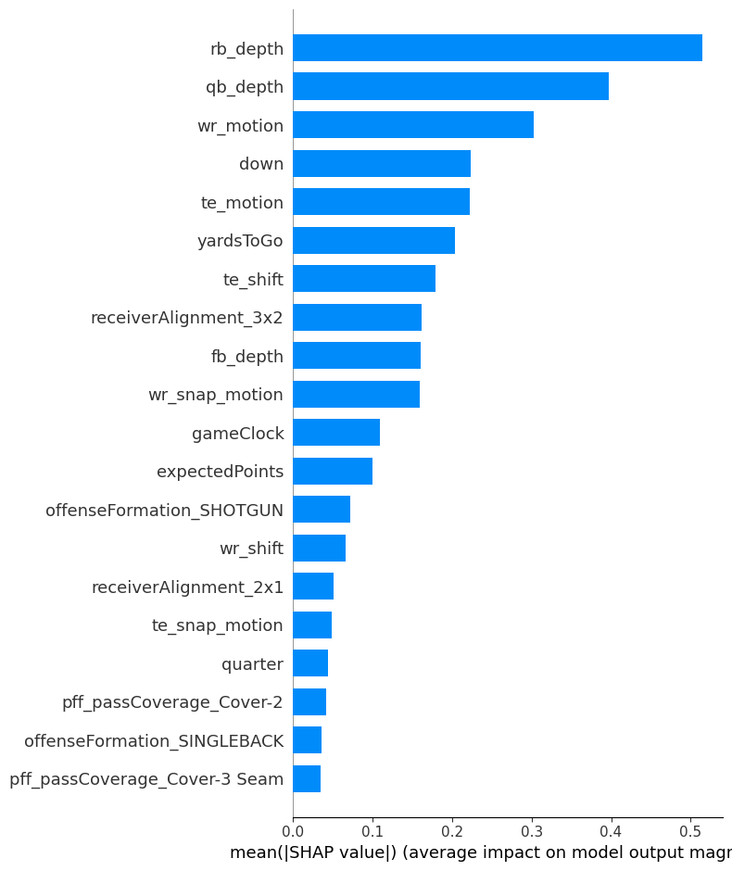
SHAP Values
Backfield Depth
Player Movement
Down & Distance
Notes:
As predicted at the beginning of the presentation, running back depth had the most impact on the model output. Furthermore, we confirmed our descriptive findings of player movement and down & distance.

Slide 15
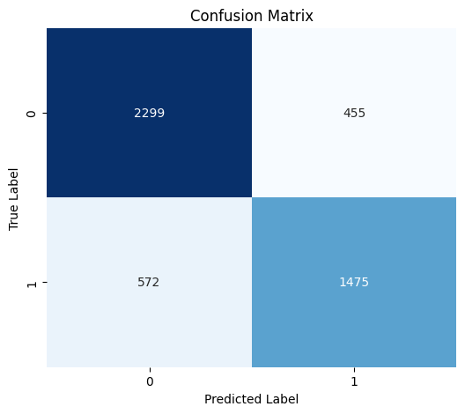
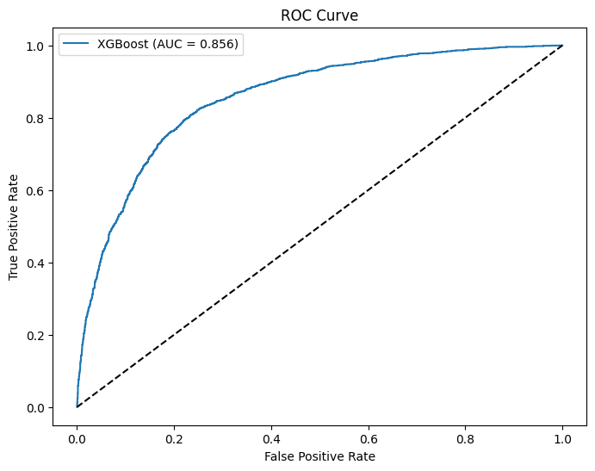
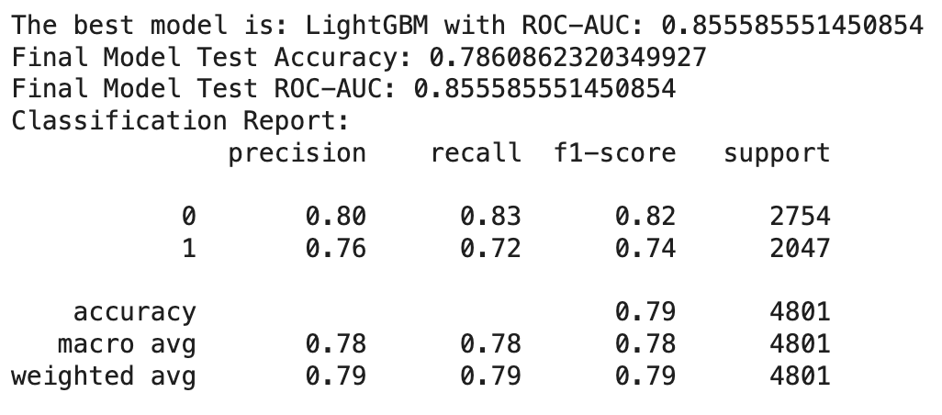
Model Performance
Notes:
After testing both XGBoost and LightGBM models, we found that the LightGBM model tested best. We found the accuracy to be 78.6% and ROC-AUC to be 85.6%. This is basically saying that with our model, one can have a much better prediction that a random guess at 50% and the model will be correct more than 3/4ths of the time. Those metrics are promising, considering in 2021, Otting’s Markov model had an accuracy of 71.6%, while Lee, Chen, and Lakshman had 75.9% accuracy with a ROC-AUC of 84.9%.

Slide 16
Coaching Recommendations
Notes:
The future is here and incorporating machine learning into your game planning will help. All 32 NFL teams have data analysts and technology is only becoming more powerful. It is worthwhile to evaluate available metrics and try to uncover a metric that could be a significant tell. This report has shown that running back depth is very significant and can be an indicator for a defensive audible. Additionally, player shifting and of course down and distance all can reveal meaningful information in an offense’s scheme.

Slide 17
Future Consideration
Notes:
As technology and generative artificial intelligence continues to sky-rocket, it is not beyond the realm of possibilities in the near future of using computer imaging to train predictive models that will be able to provide real-time analytics and predictions. Imagine the advantage in scouting your opponent if all you had to do was run their game film through a model and let the computer use its advance capabilities of picking up on even more hidden nuances. We believe we have only hit the top of the iceberg when it comes to the intersection of professional football and data science.

Slide 18
References
Saquon Barkley (image slide 2): https://commons.wikimedia.org/wiki/File:Saquon_Barkley_Giants_2018.jpg
Eagles & Redskins (image slide 3): https://www.flickr.com/photos/imatty35/6262282662
Lee P., Chen R., & Lakshman V. (unknown) Predicting Offensive Play types in the National Football League.
Marius Ötting, Predicting play calls in the National Football League using hidden Markov models, IMA Journal of Management Mathematics, Volume 32, Issue 4, October 2021, Pages 535–545, https://doi.org/10.1093/imaman/dpab005
Lee, P., Chen, R., & Lakshman, V. (n.d.). Predicting offensive play types in the NFL. Retrieved from https://cs229.stanford.edu/proj2016/report/LeeChenLakshman-PredictingOffensivePlayTypesIntheNFL-report.pdf
GitHub Repository

